Slide 1
Requirements Analysis Concepts & Principles
Software Engineering Fundamental

Slide 2
Requirements Analysis Concepts and Principles
- Requirements Analysis
- Communication Techniques
- Initiating the Process
- Facilitated Application Specification Techniques
- Analysis Principles
- Information Domain
- Modeling
- Partitioning
- Software Prototyping
- Selecting the Prototyping Approach
- Prototyping Methods and Tools
- The Software Requirements Specification
- Specification Principles
- Representation
Jerry Gao, Ph.D. Jan. 1999

Slide 3
Requirements Analysis
Requirements analysis
-> A process of discovery, refinement, modeling, and specification.
During the process, both the developers and customers take an active role.
Focus on: “what” instead of “how”
Input of the requirements analysis process:
- Software Project Plan
- System specification (if one exists)
Output: Software requirements specification document
- provides the software engineer with models that can be translated in to data, architectural, interface, and procedure design.
- customer and developer can check the quality of the software
and provide the feedback.
Who perform requirements analysis: system analysts

Slide 4
Requirements Analysis
Major tasks and efforts:
- Problem recognition (or system understanding)
- Discover and understand the system requirements
- Refine the requirements
- Evaluation and synthesis:
- what are the alternative solutions
- focus on what solution should be selected or used
instead of how to implement a solution.
- Modeling: to represent the various aspects of the system
- the required data
- information and control flow
- operation behavior
- Specification of:
- software functions, and performance
- interfaces between system elements
- system constraints

Slide 5
Requirements Analysis
Software engineering task bridging the gap between system requirements engineering and software design.
Provides software designer with a model of:
  system information
  function
  behavior
Model can be translated to data, architectural, and component-level designs.
Expect to do a little bit of design during analysis and a little bit of analysis during design.

Slide 6
Requirements Engineering Process
- Feasibility study:
- Identify and estimate to see if user needs can be satisfied
using current techniques and technologies.
- Requirements analysis:
- The process of deriving the system requirements
through observation of existing systems, discussion
with users and customers, task analysis, and so on.
Requirements definition:
- Translating the information into a REQ. document.
Requirements specification:
- Define system requirements using a consistent
precise, and complete way.
- Using some requirements specification method

Slide 7
Requirements Engineering Process
Feasibility
Study
Requirements
analysis
Requirements
definition
Feasibility
report
Requirements
specification
System
models
Definition of
requirements
Requirements
documents
Specification
of requirements

Slide 8
Requirements Analysis Process
- Domain understanding:
- Understanding of application domain.
- Requirements collections:
- The process of interacting with customers, users to discover
the requirements for the system.
- Requirements classification:
- Group and classify the gathered requirements.
- Conflict resolution:
- Resolve the conflict requirements.
- Prioritization:
- Identify and list requirements according to their importance
- Requirements validation:
- Check and validate the gathered requirements to see
if they are complete, correct, and sound.

Slide 9
Requirements Analysis Process
Requirements
definition and
specification
Requirements
validation
Domain
understanding
Prioritization
Requirements
collection
Conflict
resolution
Classification

Slide 10
Communication Techniques
Initiating the Process:
Q1 set: Context free questions to lead the basic understanding of the problem
Who is behind the solution?
Who will use the solution?
…..
Q2 set: Questions to gain a better understanding of the problem and the customer’s perceptions about a solution.
How would you characterize “good” output that would be generated by a successful solution?
What problems will this solution address?
Q3 set: Meta-questions focus on the effectiveness of the meeting.
Are you the right person to answer these questions? Are your answers “official”?

Slide 11
Facilitated Application Specification Techniques (FAST)
Customers and software engineers often have an unconscious “us and them” mind set.
This may cause: misunderstandings, miss important information,….
To solve the problem, FAST approach is proposed.
FAST encourages the creation of a joint team of customers and developers.
They work together
- to identify the problem and proposed and
- to negotiate the different elements of solutions and approaches
The basic guidelines of FAST:
- hold a meeting at a neutral site
- establish rules for preparation and participation
- have a formal meeting agenda
- control the meeting by a “facilitator”
- use a “definition mechanisms”
- have a common goal to
- identify the problem
- propose elements of solutions and requirements
- negotiate different approaches

Slide 12
Quality Function Deployment
Quality function deployment (QFD) is quality management technique
- Translate the needs of the customer into technical requirements for software.
QFD identifies three types of requirements:
- Normal requirements:
Objectives and goals:
examples: types of graphic displays, specific system functions
- Expected requirements:
implicit requirements:
examples: ease of human-machine interaction
ease of software installation
- Exciting requirements:
Features go beyond the customer’s expectations

Slide 13
Analysis Principles
Each analysis method has a unique point of view.
All analysis methods are related by a set of operational principles:
- represent and understand the information domain
- define the functions that the software
- represent the behavior of the software
- use models to depict information, function, and behavior
--> uncover the details in a layered fashion.
- move from essential information toward to details
A set of guidelines for requirement engineering:
- understand the problem before beginning to create the analysis model
- develop prototypes to help user to understand how human-machine interactions
- record the origin of and the reasons for every requirement
- use multiple views of requirements
- prioritize requirements
- work to eliminate ambiguity

Slide 14
The Information Domain
Software is built to process data, to transform data from one form to another.
Software also process events.
The first operational analysis principle requires to exam the information domain.
Information domain contains three different views of the data and control:
- information content and relationship:
information content --> represent the individual data and control objects
there are different relationships between data and objects
- information flow:
represents the manner in which data and control change as each moves through
a system. Data and control moves between two transformations (functions)
- information structure:
represent the internal organization of various data and control items
- data tree structure
- data table (n-dimension)

Slide 15
Modeling
During software requirements analysis, we create models of the system to be built.
The models focus on:
- what the system must do, not how it does it.
The models usually have a graphic notation to represent:
- information, processing, system behavior, and other features
The second and third operational analysis principles require:
- build models of function and behavior
- Functional models
Software transforms information. Three generic functions:
- input, processing, output
- Behavior models
Most software responds to events from the outside world
A behavior model creates a representation of the states of the software
and events that cause software to change state
Important roles of models:
- The model aids the analyst in understanding the information, function, and
behavior of a system.
- The model becomes the focal point for review in the aspects of
completeness, consistency, and accuracy of the specification.
- The model becomes the foundation for design, providing the designer
with an essential representation of software.

Slide 16
Partitioning
Partitioning decomposes a problem into its constituent parts.
Establish a hierarchical representation of information (or function):
- exposing increasing detail by moving vertically in the hierarchy
- decomposing the problem by moving horizontally in the hierarchy.
Horizontal partition
SafeHome Software
Configure system
Monitor sensors
Interact with user
Vertical partition
Poll for sensor event
Activate alarm functions
Activate audible alarm
Dial phone number

Slide 17
Software Prototyping
In some cases, it is possible to apply operational analysis principles and derive a model of software from which a design can be developed.
Selecting the prototyping approach:
The closed-ended approach is called throwaway prototyping.
- a prototype serves only as a rough demonstration of requirements.
The open-ended approach is called evolutionary prototyping.
- a prototype serves as the first evolution of the finished system.
Figure 11.7 selecting the appropriate prototyping approach.
Prototyping Methods and Tools:
- Fourth Generation Techniques
- Reusable Software Components
- Formal Specification and Prototyping Environments

Slide 18
Software Specification
Specification principles:
- Separate functionality from implementation
- Develop a model of the desired behavior of a system
- Establish the context in which software operates
- Define the environment in which the system operates
- Create a cognitive model rather than a design or implementation model
- Specification is an abstract model of a real system
- Establish the content and structure of a specification (easy to be changed)
Guidelines for representation:
- Representation format and content should be relevant to the problem
- Information contained within the specification should be nested
-Diagrams and other notational forms should be restricted in number and consistent in use.
- Representations should be revisable
Software requirements specification standard:
IEEE (standard No. 830-1984) and U.S. Department of Defense
In many cases, a preliminary user’s manual should be provided to presents the software
as a black box.

Slide 19
Analysis Objectives
Identify customer’s needs.
Evaluate system for feasibility.
Perform economic and technical analysis.
Allocate functions to system elements.
Establish schedule and constraints.
Create system definitions.

Slide 20
Feasibility Study
Economic feasibility
  cost/benefit analysis
Technical feasibility
  hardware/software/people, etc.
Legal feasibility
Alternatives
  there is always more than one way to do it

Slide 21
System Specification
Introduction.
Functional data description.
Subsystem description.
System modeling and simulation results.
Products.
Appendices.

Slide 22
Requirements
Requirement
  features of system or system function used to fulfill system purpose.
Focus on customer’s needs and problem, not on solutions:
  Requirements definition document
    (written for customer).
  Requirements specification document
    (written for programmer; technical staff).

Slide 23
Requirement Validation
Correct?
Consistent?
Complete?
  Externally - all desired properties are present.
  Internally - no undefined references.
Each requirement describes something actually needed by the customer.
Requirements are verifiable (testable)?
Requirements are traceable.

Slide 24
Requirements Definition Document
General purpose of document.
System background and objectives.
Description of approach.
Detailed characteristics of proposed system (data & functionality).
Description of operating environment.

Slide 25
Software Requirements Elicitation
Customer meetings are the most commonly used technique.
Use context free questions to find out
  customer's goals and benefits
  identify stakeholders
  gain understanding of problem
  determine customer reactions to proposed solutions
  assess meeting effectiveness
Interview cross section of users when many users are anticipated.

Slide 26
most common technique is to sit down with the clients and ask them what they need.
discussion should be planned out ahead of time based on the type of requirements you’re looking for
Privacy of everyone • in-depth a stakeholder’s thoughts and get his or her perspective Benefits • Time Consuming • Misunderstandings Risks & Drawbacks
Prototyping is a relatively modern technique for gathering requirements
In a facilitated session, bring a larger group (five or more) together for a common purpose and try to gather a set of common requirements from the group in a faster manner than each of them separately
Questionnaires are much more informal, and they are good tools to gather requirements from stakeholders in remote locations
In the field of software engineering reusing the requirements of the existing system is common method of requirements elicitation

Slide 27
Requirements Views
Essential view
  presents the functions to be accomplished and the information to be processed while ignoring implementation
Implementation view
  presents the real world realization of processing functions and information structures
Avoid the temptation to move directly to the implementation view and assuming that the essence of the problem is obvious.

Slide 28
Specification Principles - 1
Separate functionality from implementation.
A process-oriented specification language is needed.
Specification must encompass the system containing the software component.
Specification must encompass the environment.
System specification = cognitive model.

Slide 29
Specification Principles - 2
Specification must be operational (talk about how it works).
Must be tolerant of incompleteness and easy to add to.
Specification must be localized and loosely coupled (pieces of things are independent of each other).

Slide 30
Specification Representation
Representation format and content should be relevant to the problem.
Information contained within the specification should be nested.
Diagrams and other notational forms should be restricted in number and consistent in use.
Representations should be revisable.

Slide 31
Specification Review
Conducted by customer and software developer.
Once approved, the specification becomes a contract for software development.
The specification is difficult to test in a meaningful way.
Assessing the impact of specification changes is hard to do.

Slide 32
Requirements Review
Goals & objectives review.
Compare requirements to goals & objectives.
Consider system operating environment.
Assess and document all risks in system developmental operation.
Discuss testing procedure.

Slide 33
Evaluating Specification Techniques - 1
Requirements are understandable to naive user.
Requirements form basis for design and testing.
Automated requirements checking?
Requirements form external view of system.

Slide 34
Evaluating Specification Techniques - 2
Technique aid in organizing and structuring requirements.
Technique for prototyping.
Automatic test case generation from requirements.
Appropriate for application.

Slide 35
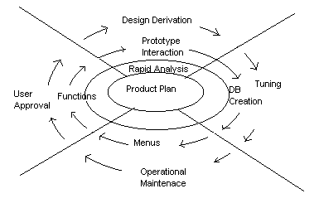
Evolutionary Rapid Prototyping

Slide 36
E.R.P. Process
Goal is to write less throw away code than spiral model
Starts with project plan and plans for software evolution
Risks/Unknowns favoring ERP use:
  Customer requirements
  Technology
  Interfaces

Slide 37
E.R.P. Risks
Premature delivery.
Premature design selection.
Features in prototype can get lost in final product.
There is a tendency to choose efficiency of production over product modifiability.

Slide 38
E.R.P. Advice
Focus on what will take least amount of programming time over maintainability.
With rapid prototyping don’t write code until ready.
Spiral model any code written may be thrown out after risk assessment.

Slide 39
E.R.P. Analysis
What.
When.
Cost.
Completion.
Re-use.
Contingencies.
Rewards.

Slide 40
Implementation and Testing
Code.
Test.
Debug.
Go to 1 (repeat).

Slide 41
Data Modeling
the process of documenting a complex software system design as an easily understood diagram, using text and symbols to represent the way data needs to flow.
The diagram can be used as a blueprint for the construction of new software or for re-engineering a legacy application.
Traditionally, have been built during the analysis and design phases of a project to ensure that the requirements for a new application are fully understood.
can be thought of as a flowchart that illustrates the relationships between data.
Approaches to data modeling:
Conceptual Data Modeling - identifies the highest-level relationships between different entities.
Enterprise Data Modeling - similar to conceptual data modeling, but addresses the unique requirements of a specific business.
Logical Data Modeling - illustrates the specific entities, attributes and relationships involved in a business function. Serves as the basis for the creation of the physical data model.
Physical Data Modeling - represents an application and database-specific implementation of a logical data model.

Slide 42
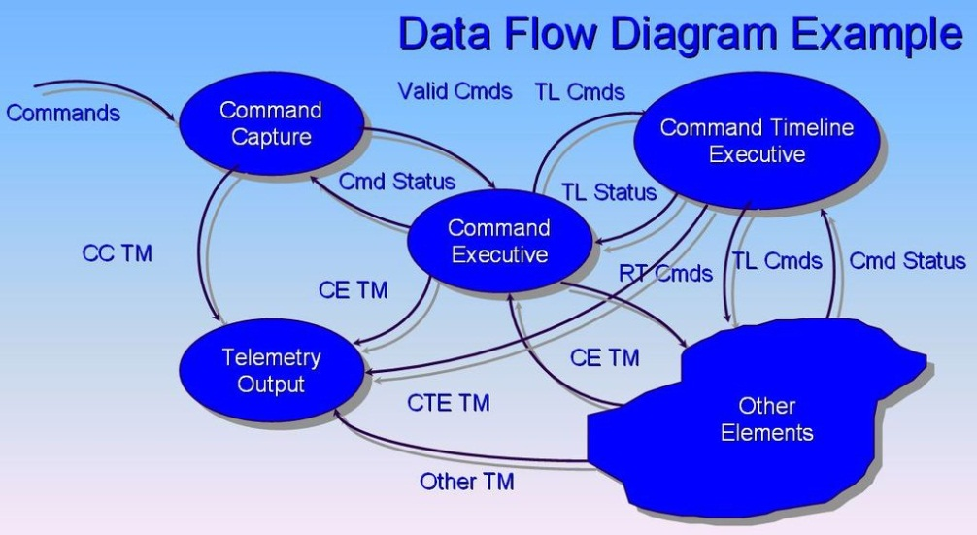
Functional Modeling
Data flow diagrams(DFDs)
A data flow diagram (DFD) is a graphical representation of the "flow" of data through an information system.
It differs from the system flowchart as it shows the flow of data through processes instead of computer hardware.
Data flow diagrams were invented by Larry Constantine, developer of structured design, based on Martin and Estrin's "data flow graph" model of computation.
The DFD is designed to show how a system is divided into smaller portions and to highlight the flow of data between those parts.
With a data flow diagram, users are able to visualize how the system will operate, what the system will accomplish, and how the system will be implemented.

Slide 43
The old system's data flow diagrams can be drawn up and compared with the new system's data flow diagrams to draw comparisons to implement a more efficient system.
Data flow diagrams can be used to provide the end user with a physical idea of where the data they input ultimately has an effect upon the structure of the whole system from order to dispatch to recook.
Behavioural modeling
All behavioural models really do is describe the control structure of a system. This can be things like:
Sequence of operations
Object states
and Object interactions
Furthermore, this modelling layer can also be called Dynamic Modelling.
The activity of creating a behavioural model is commonly known as behavioural modelling. As well as this, a system should also only have one behavioural model – much like functional modelling.
(Design) Sequence Diagrams
Communication Diagrams or collaboration diagram
State Diagrams or state machine diagram or state chart

Slide 44
Structured Analysis
Structured analysis is part of a series of structured methods that "represent a collection of analysis, design, and programming techniques that were developed in response to the problems facing the software world
Structured analysis (SA) and structured design (SD) are methods for analyzing business requirements and developing specifications for converting practices into computer programs, hardware configurations, and related manual procedures.
Structured analysis and design techniques are fundamental tools of systems analysis
views a system from the perspective of the data flowing through it
They developed from classical systems analysis of the 1960s and 1970s.
consists of interpreting the system concept (or real world situations) into data and control terminology represented by data flow diagrams
Structured analysis takes advantage of information hiding through successive decomposition (or top down) analysis

Slide 45
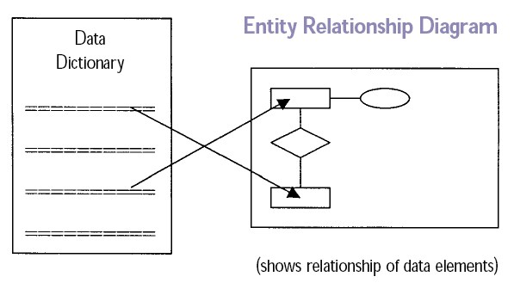
The result of structured analysis is a set of related graphical diagrams, process descriptions, and data definitions. They describe the transformations that need to take place and the data required to meet a system's functional requirements.
Data Dictionary
A data dictionary or database dictionary is a file that defines the basic organization of a database.
A database dictionary contains a list of all files in the database, the number of records in each file, and the names and types of each data field.
Data dictionaries do not contain any actual data from the database, only bookkeeping information for managing it.
Without a data dictionary, however, a database management system cannot access data from the database.

Slide 46
Database users and application developers can benefit from an authoritative data dictionary document that catalogs the organization, contents, and conventions of one or more databases.
A data dictionary document also may include further information describing how data elements are encoded.
One of the advantages of well-designed data dictionary documentation is that it helps to establish consistency throughout a complex database, or across a large collection of federated databases.

